Slide 1
The Chemistry of Hair Conditioners
CH 419- Consumer Chemistry
By- Karn Pratap Singh & Ayushmaan Singh

Slide 2
TABLE OF CONTENTS
01
02
03
Overview
Introduction in depth
How it works?
04
05
Types of hair conditioner
Conclusion

Slide 3
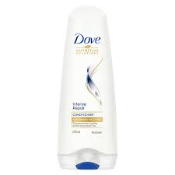
Overview
Conditioner is typically the second step to hair washing. While cleanser or shampoo is formed explicitly to clear off sweat, dead skin cells, and hair items, conditioner makes hair gentler and more easy to manage. It likewise shields hair shafts from damage. Most shampoos use synthetics that are harsh on hair follicles.

Slide 4
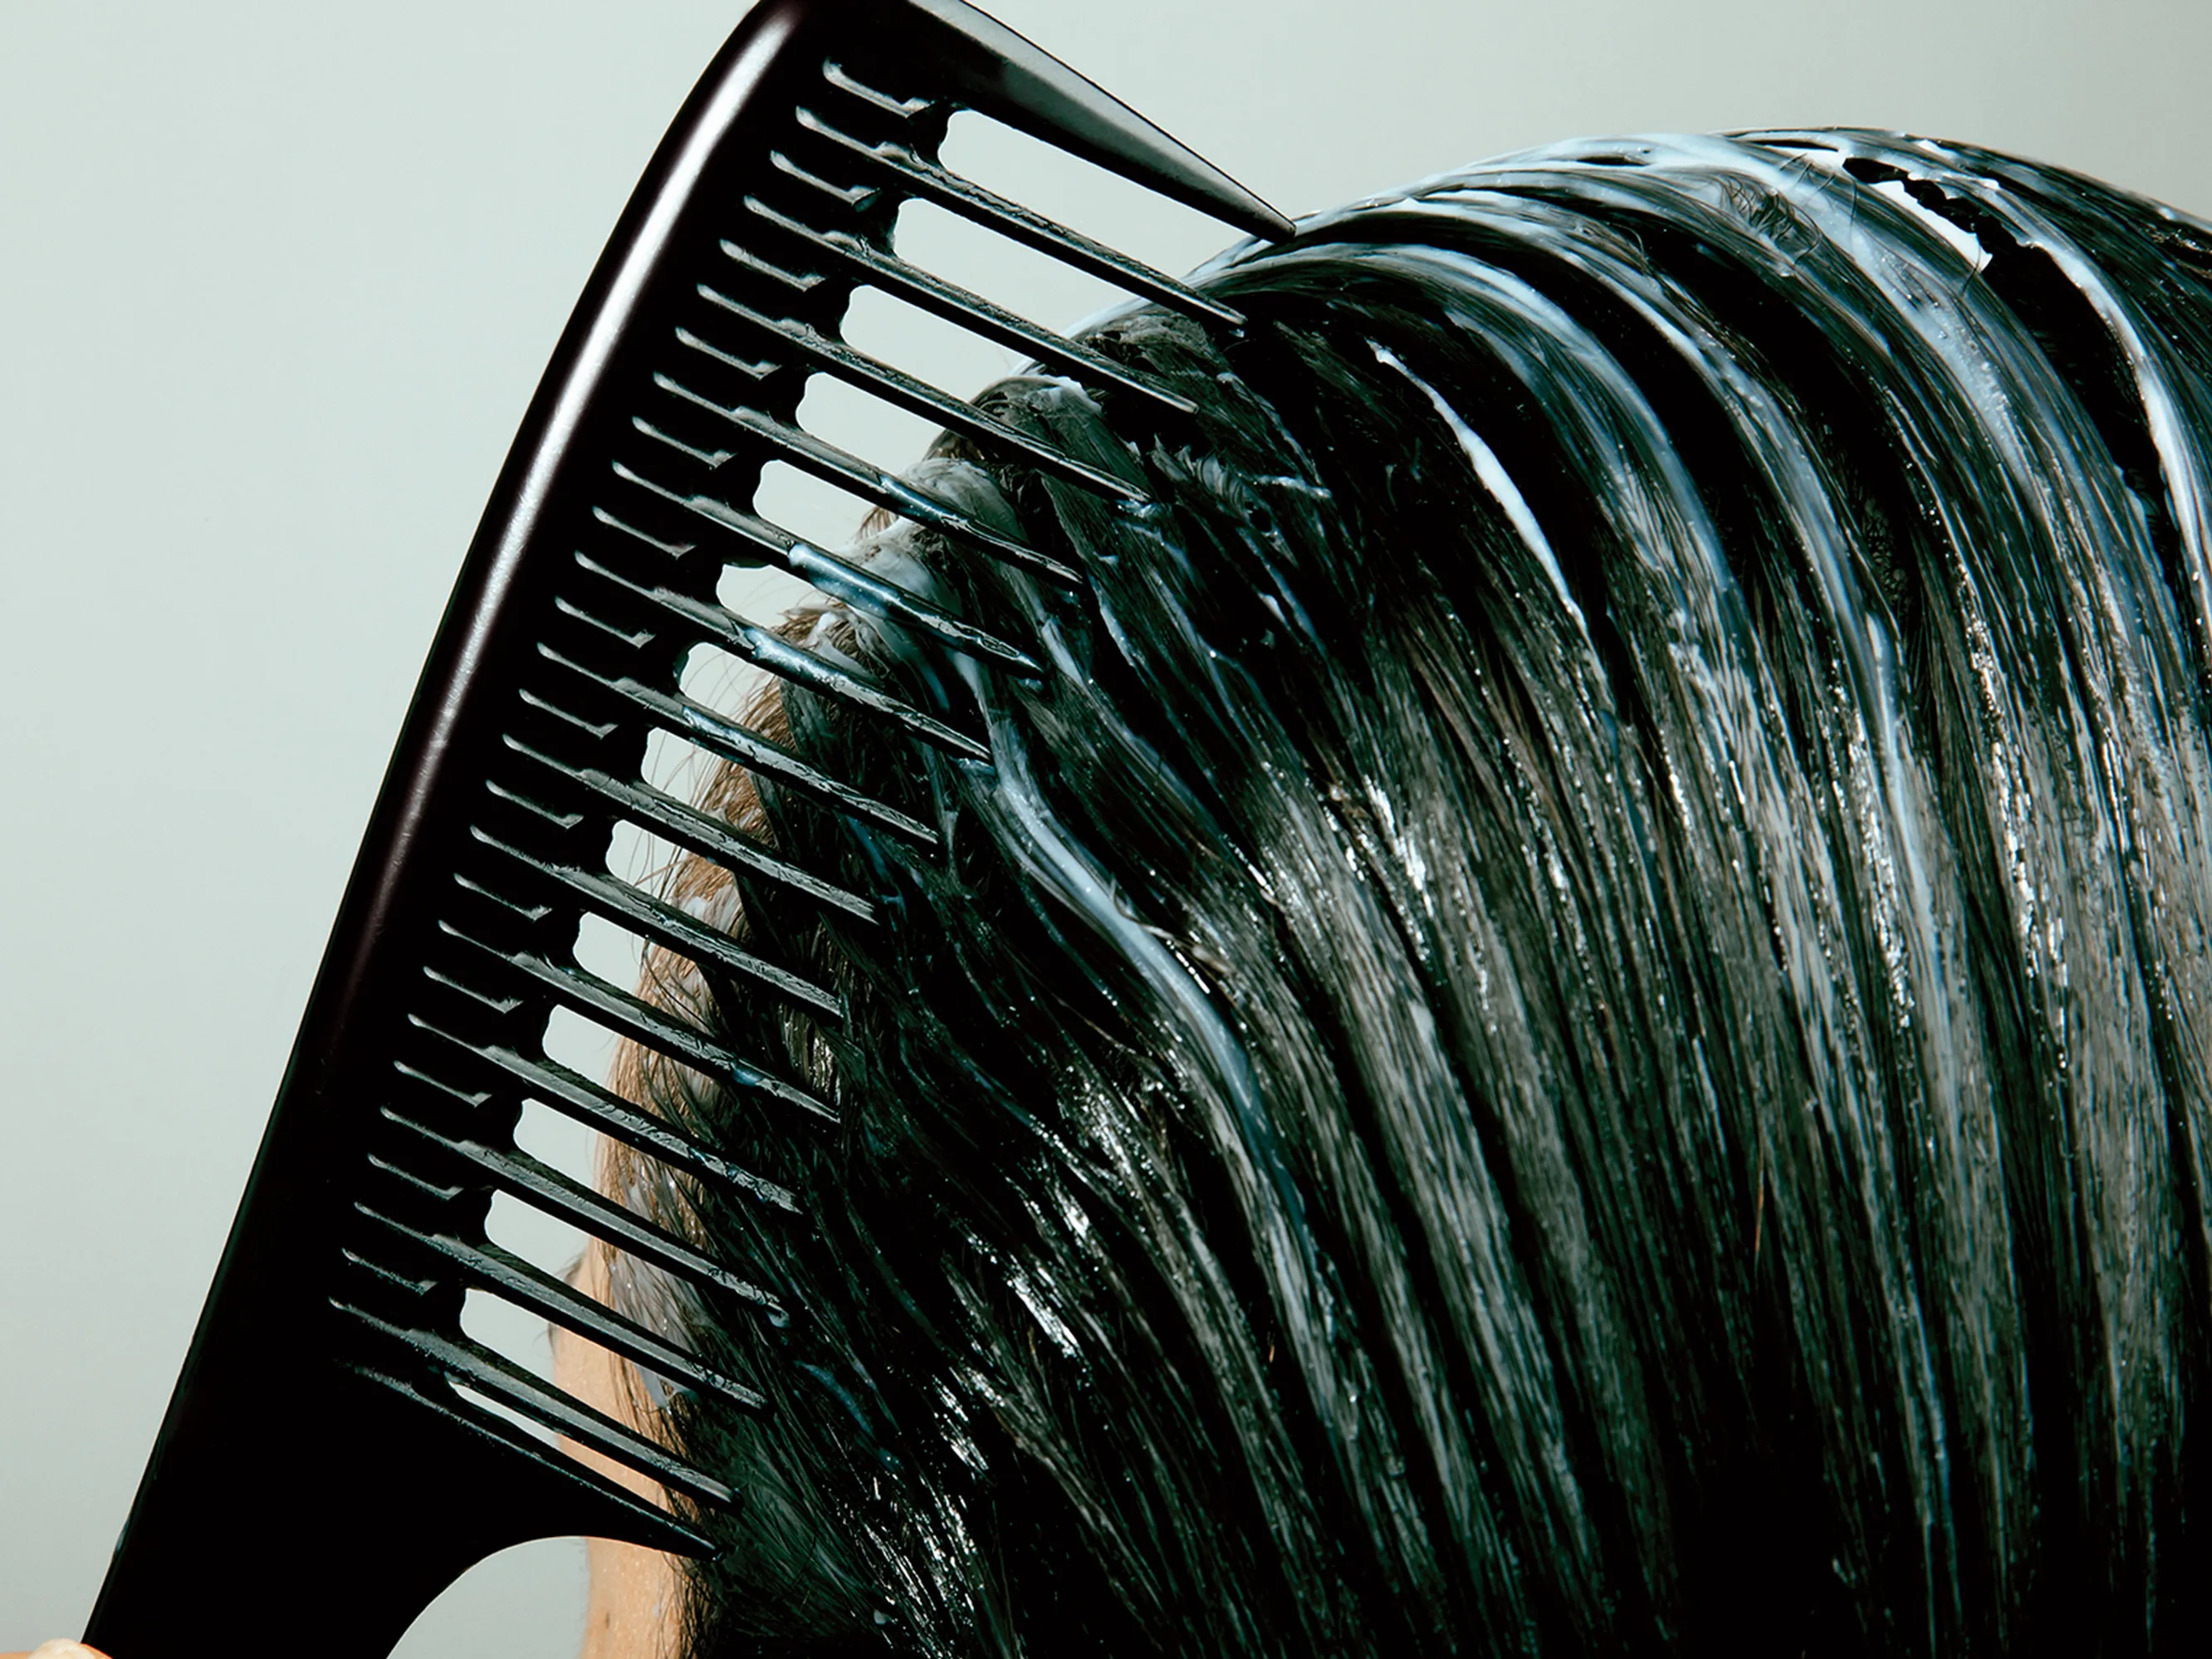
Introduction in depth
Hair conditioner is for the most part comprised of a few parts like humectants, oils, and cationic surfactants (the logical term for soap or detergent that contain emphatically charge on their hydrophilic end).
Its primary intention is to lessen friction between strands of hair to permit smoother brushing , which could somehow harm the scalp. Various different advantages are frequently promoted, for example, hair repair, fortifying, or a decrease in split ends.

Slide 5
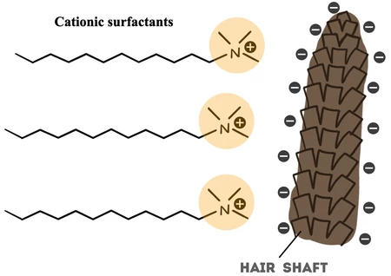
How it works?
The chemistry behind the hair conditioner is that the positively charged surfactant will bind to the negatively charged hair strand, which create a strong attraction that allow the surfactants to cover the hair shaft completely. A trace amount of acid in conditioner will make the overlayed cuticle flakes to lay tightly even after the conditioner is rinsed out. To top it all off, the hair conditioner can smoothen hair strands and making it less static, as well as keeping the moisture in and pollutants out. Daily wear and tear from pulling hair back in headbands or ponytails can damage the hair shaft. The conditioner recovers the damage by refortifying the cuticle and coats the hair shaft to preventing breakage, split ends, and even hair loss.

Slide 6
Types of Hair Conditioner
Rinse-out conditioner: This is the most common type of conditioner that is used after shampooing. It helps to detangle and soften the hair, making it more manageable.
Leave-in conditioner: This type of conditioner is left in the hair after washing, and helps to hydrate and protect the hair throughout the day
Deep conditioner: This is a more intensive conditioning treatment that is designed to penetrate the hair shaft and provide deep hydration and repair. It is usually left on the hair for a longer period of time, often with the help of heat, to enhance its effectiveness.
Co-wash conditioner: Co-washing involves using a conditioner instead of shampoo to cleanse the hair. Co-wash conditioners are formulated to be gentle and moisturizing, and are suitable for those with dry or damaged hair.
Protein conditioner: This type of conditioner contains hydrolysed proteins that help to strengthen the hair and prevent breakage. It is especially beneficial for those with weak or damaged hair.

Slide 7
UPCOMING EVENTS

